Slide 1
Huffman Code

Slide 2
Building a Tree
Scan the original text
Consider the following text:
Eerie eyes seen near lake.
Count up the occurrences of all characters in the text

Slide 3
Building a Tree
Scan the original text
Eerie eyes seen near lake.
What characters are present?
E e r i space
y s n a r l k .

Slide 4
Building a Tree
Scan the original text
Eerie eyes seen near lake.
What is the frequency of each character in the text?
Char Freq. Char Freq. Char Freq.
E 1 y 1 k 1
e 8 s 2 . 1
r 2 n 2
i 1 a 2
space 4 l 1

Slide 5
Building a Tree
Prioritize characters
Create binary tree nodes with character and frequency of each character
Place nodes in a priority queue
  The lower the occurrence, the higher the priority in the queue

Slide 6
Building a Tree
The queue after inserting all nodes
E
1
i
1
y
1
l
1
k
1
.
1
r
2
s
2
n
2
a
2
sp
4
e
8

Slide 7
Building a Tree
E
1
i
1
y
1
l
1
k
1
.
1
r
2
s
2
n
2
a
2
sp
4
e
8
Eerie eyes seen near lake.  26 characters

Slide 8
Building a Tree
y
1
l
1
k
1
.
1
r
2
s
2
n
2
a
2
sp
4
e
8
2
E
1
i
1

Slide 9
Building a Tree
y
1
l
1
k
1
.
1
r
2
s
2
n
2
a
2
2
sp
4
e
8
E
1
i
1

Slide 10
Building a Tree
k
1
.
1
r
2
s
2
n
2
a
2
2
sp
4
e
8
E
1
i
1
2
y
1
l
1

Slide 11
Building a Tree
k
1
.
1
r
2
s
2
n
2
a
2
2
2
sp
4
e
8
y
1
l
1
E
1
i
1

Slide 12
Building a Tree
r
2
s
2
n
2
a
2
2
2
sp
4
e
8
y
1
l
1
E
1
i
1
2
k
1
.
1

Slide 13
Building a Tree
r
2
s
2
n
2
a
2
2
2
sp
4
e
8
2
E
1
i
1
y
1
l
1
k
1
.
1

Slide 14
Building a Tree
n
2
a
2
2
sp
4
e
8
2
2
E
1
i
1
y
1
l
1
k
1
.
1
4
r
2
s
2

Slide 15
Building a Tree
n
2
a
2
2
sp
4
e
8
2
2
4
E
1
i
1
y
1
l
1
k
1
.
1
r
2
s
2

Slide 16
Building a Tree
2
4
e
8
2
2
sp
4
y
1
l
1
k
1
.
1
r
2
s
2
E
1
i
1
4
n
2
a
2

Slide 17
Building a Tree
2
4
4
e
8
2
2
sp
4
y
1
l
1
k
1
.
1
r
2
s
2
n
2
a
2
E
1
i
1

Slide 18
Building a Tree
4
4
e
8
2
sp
4
k
1
.
1
r
2
s
2
n
2
a
2
4
2
2
E
1
i
1
y
1
l
1

Slide 19
Building a Tree
2
4
4
4
sp
4
e
8
2
2
k
1
.
1
r
2
s
2
n
2
a
2
E
1
i
1
y
1
l
1

Slide 20
Building a Tree
4
4
4
e
8
2
2
r
2
s
2
n
2
a
2
E
1
i
1
y
1
l
1
6
2
sp
4
k
1
.
1

Slide 21
Building a Tree
4
4
4
6
e
8
2
sp
4
r
2
s
2
n
2
a
2
2
2
k
1
.
1
E
1
i
1
y
1
l
1
What is happening to the characters with a low number of occurrences?

Slide 22
Building a Tree
4
6
e
8
2
2
2
sp
4
E
1
i
1
y
1
l
1
k
1
.
1
8
4
4
r
2
s
2
n
2
a
2

Slide 23
Building a Tree
4
6
e
8
8
2
2
2
sp
4
4
4
E
1
i
1
y
1
l
1
k
1
.
1
r
2
s
2
n
2
a
2

Slide 24
Building a Tree
e
8
8
4
4
10
r
2
s
2
n
2
a
2
4
6
2
2
2
sp
4
E
1
i
1
y
1
l
1
k
1
.
1

Slide 25
Building a Tree
e
8
8
10
4
4
4
6
n
2
a
2
2
2
2
r
2
s
2
sp
4
E
1
i
1
y
1
l
1
k
1
.
1

Slide 26
Building a Tree
10
16
4
6
2
2
2
e
8
8
sp
4
E
1
i
1
y
1
l
1
k
1
.
1
4
4
r
2
s
2
n
2
a
2

Slide 27
Building a Tree
10
16
4
6
e
8
8
2
2
2
sp
4
4
4
E
1
i
1
y
1
l
1
k
1
.
1
r
2
s
2
n
2
a
2

Slide 28
Building a Tree
After enqueueing this node there is only one node left in priority queue.
26
16
10
4
e
8
8
6
2
2
2
sp
4
4
4
E
1
i
1
y
1
l
1
k
1
.
1
r
2
s
2
n
2
a
2

Slide 29
The Tree
26
16
10
4
e
8
8
6
2
2
2
sp
4
4
4
E
1
i
1
y
1
l
1
k
1
.
1
r
2
s
2
n
2
a
2

Slide 30
The Tree
This tree contains the new code words for each character.
Frequency of root node should equal number of characters in text.
26
16
10
4
e
8
8
6
2
2
2
4
sp
4
4
E
1
i
1
y
1
l
1
k
1
.
1
r
2
s
2
n
2
a
2
Eerie eyes seen near lake.  26 characters

Slide 31
Encoding the File
Traverse Tree for Codes
Char Code
E 0000
i 0001
y 0010
l 0011
k 0100
. 0101
space 011
e 10
r 1100
s 1101
n 1110
a 1111
26
16
10
4
e
8
8
6
2
2
2
4
sp
4
4
E
1
i
1
y
1
l
1
k
1
.
1
r
2
s
2
n
2
a
2

Slide 32
Encoding the File
Rescan text and encode file using new code words
Eerie eyes seen near lake.
Char Code
E 0000
i 0001
y 0010
l 0011
k 0100
. 0101
space 011
e 10
r 1100
s 1101
n 1110
a 1111
0000101100000110011100010101101101001111101011111100011001111110100100101
Why is there no need for a separator character?

Slide 33
Encoding the File
Results
Have we made things any better?
73 bits to encode the text
ASCII would take 8 * 26 = 208 bits
0000101100000110011100010101101101001111101011111100011001111110100100101
If modified code used 4 bits per character,
Total bits 4 (bits) * 26 (chars) = 104.
Savings are not as great.

Slide 34
Decoding the File
How does receiver know what the codes are?
Tree constructed for each text file.
  Considers frequency for each file
  Big hit on compression, especially for smaller files
Tree predetermined
  based on statistical analysis of text files or file types
Data transmission is bit based versus byte based

Slide 35
Decoding the File
Once receiver has the tree, it scans incoming bit stream
0 ⇒ go left
1 ⇒ go right
26
16
10
4
e
8
8
6
2
2
2
4
sp
4
4
E
1
i
1
y
1
l
1
k
1
.
1
r
2
s
2
n
2
a
2

Slide 36
Huffman Code
Analysis

Slide 37
Huffman Encoding : Analysis
Let us construct the Huffman code for the following set of objects: a, b, c, d, e with the probabilities p(a)=…=p(e) = 0.2
1) a (p=0.2), b (p=0.2), c (p=0.2), d (p=0.2), e (p=0.2)
2) d, e → de (p=0.4) => de, a, b, c
3) b, c → bc (p=0.4) =>de, bc, a
4) a, bc → abc (p=0.6) => abc, de
5) abc, de → abcde (p=1)

Slide 38
Huffman Encoding - Analysis
abcde
0
1
abc
de
0
1
0
1
a
bc
d
e
0
1
b
c
Encoding vectors:
a → (00); b → (010); c → (011); d → (10); e → (11)

Slide 39
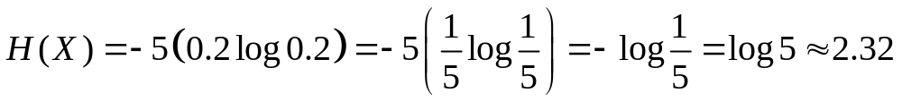
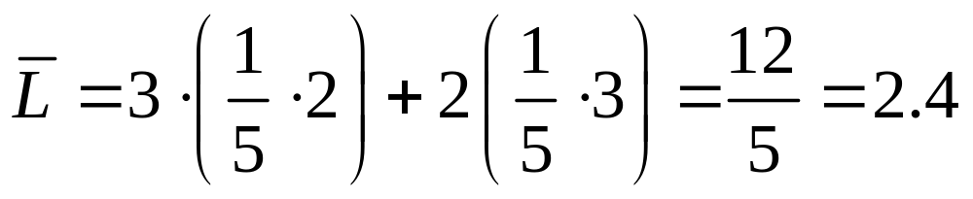
Huffman Encoding - Analysis
Entropy
Average length of the encoding vector
The Huffman code gives efficiency =
(2.32/2.4) x 100% = 97%

Slide 40
Huffman Encoding - Analysis
Entropy = -_{i=1,n} (p_{i} log₂ p_{i})
Average length of the encoding vector
Average length =
_{i=0,n} (length*frequency)/ _{i=0,n} frequency
Efficiency = Entropy / Average length (in %)

Slide 41
Huffman Code
Working Example Compressing text

Slide 42

First Approach
Consider the word
How to write this string in a most economical way?
Since it has 5 letters, 3 bits are required to represent it!!
3 bits per word x 11 letters = 33 bits
Is there a better way?

Slide 43

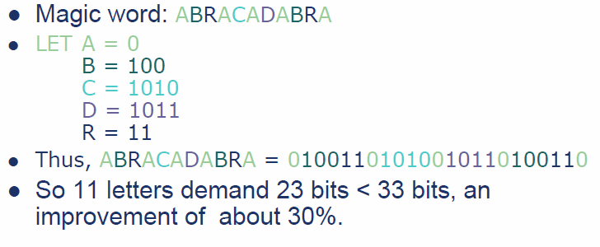
Second Approach

Slide 44
Caution
There are some concerns…
Suppose we have
  A-> 01
  B-> 0101
If we have 010101, is this AB? BA? Or AAA?
Use Prefix Codes
Prefix Codes - no codeword is a prefix of another codeword

Slide 45
Prefix Codes
Any Prefix Code can be represented by a full binary tree.
Each leaf stores a symbol.
Each node has two children –
left branch means 0, right branch means 1.
The codeword = path from the root to the leaf interpreting suitably the left and right branches.

Slide 46
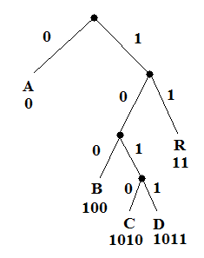
For Example
A = 0
B = 100
C = 1010
D = 1011
R = 11
Decoding is unique and simple!

Slide 47
How do we find the optimal coding tree?
The two symbols with the smallest frequencies go to the bottom of the optimal tree, as children of the lowest internal node.
We have to use a bottom-up manner to build the code!
Huffman’s idea is based on a greedy approach.

